Slide 1
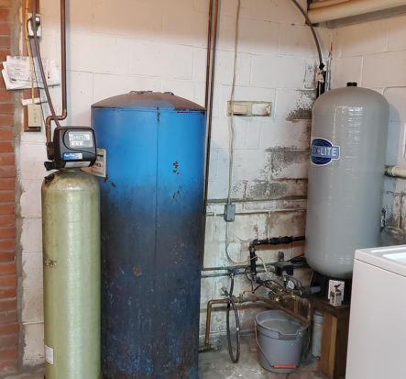
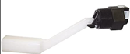
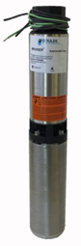
Water Cleaning System
Step3
Aqua-Pure Iron and Manganese Reduction System Model APIF100DM
SN 613114A519
Installed 2014
Serviced 10/2018, 8/2020
Step2
Mark 10
Bonded Glass-Lined Standard Tank
Step1
Flex~Lite Well Tank
(35 galons, 2018)- store/ deliver water under pressure between pumps
https://flexconind.com/product/flex-lite-series/
Fritz Bros., Inc.
Well drilling, plumbing,
water-softening
Address: 100 Cliff St,
Honesdale, PA 18431
Phone: (570) 253-2660
Hours: Mon-Sat 7am-4pm
Also Deep Well
Merrill AE-10 Air Ejector Control
Step0
goulds pumps bruiser submersible pump
Model 7SB05422C
with 230V motor (1/2 horse power)
4" Submersive Pump from ITT Gould Pumps
7 gallons per minute
.. https://goulds.com
.. https://www.gouldspumps.com

Slide 2
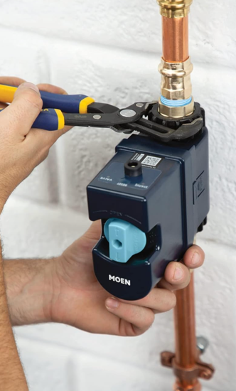
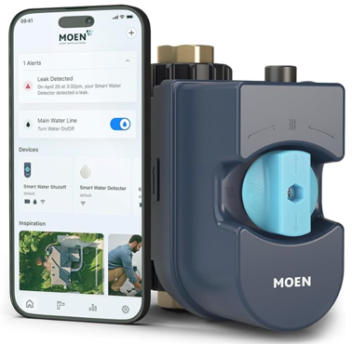
Water flow measuring and shut-off
thinking about buying the FLO by Moen:
Moen 900-001 Flo Smart Water Monitor and Automatic Shutoff Sensor, Wi-Fi Water Leak Detector for 3/4-Inch Diameter Pipe - $350
https://www.amazon.com/dp/B00C03D01Q It can monitor water usage, alert and automatically shut-off in case of leaks

Slide 3
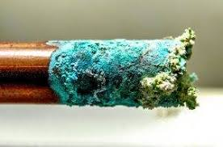
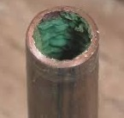
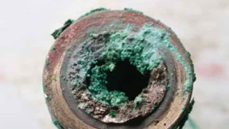
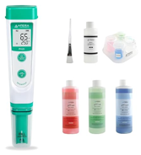
Why the water is blue blue after Aqua-Pure APIF100DM ?
If the water appears blue after passing through the Aqua-Pure APIF100DM system, it could indicate one of the following issues:
Copper Corrosion: Blue or greenish water is often caused by copper leaching from plumbing pipes or fixtures. This can happen if the water is too acidic (low pH) or if the system is not properly neutralizing the water.
Oxidation Reactions: The system may be oxidizing certain metals or minerals in your water supply, which could give the water a bluish tint. This could occur if there are trace amounts of copper, manganese, or other metals in the water.
Contamination or Residue in the System: If the system has not been flushed properly after installation, maintenance, or regeneration, residual chemicals or media fines (e.g., manganese dioxide) might discolor the water.
Steps to Address the Issue:
Test Water pH: Check if the water pH is within the recommended range (6.5–8.5). If it is too acidic, consider installing a pH neutralizer.
Inspect Plumbing: Look for signs of copper corrosion in your pipes and address any issues with a plumber.
Flush the System: Perform a thorough flush of your system to remove any trapped air, fines, or residue from the filter media.
Check for Maintenance Needs: Ensure that all components of your system are functioning properly and that regeneration cycles are being conducted as recommended.
Consult a Professional: If the issue persists, contact a water treatment specialist to inspect your system and analyze your water for potential contaminants like copper or other metals.
products of copper oxidation :
- Malachite (dark green to blue)
- Azurite (blue to purple)
Copper oxide or carbonate, formed through prolonged exposure to moisture and air.
pH measurement:
https://www.amazon.com/dp/B077Z6LF91
APERA INSTRUMENTS AI209-T Value Series PH20 pH Tester Combo Kit

Slide 4
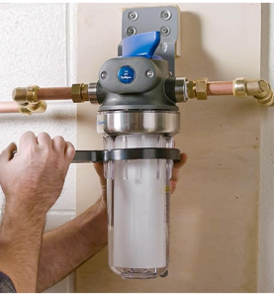
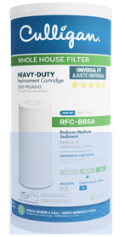
Whole House Water Filter
Whole House Water Sediment Filter (25 micron)
Reduces sediment, dirt, sand, silt, and rust particles down to 25 microns.
Typically made of polypropylene or similar materials.
Often used as a first stage in whole house filtration systems.
Filter life: Usually 3-6 months or 20,000-60,000 gallons, depending on water quality.
Does not address chemical contaminants or dissolved minerals.
Aqua-Pure Iron and Manganese Reduction System (APIF100DM)
Reduces iron, manganese, and adjusts pH.
Uses a chemical-free process to reduce ferrous (dissolved) and bacterial iron.
Incorporates air induction for iron oxidation.
Includes a bypass valve with multiple positions, including a diagnostic mode.
Designed for high iron content in water and hydrogen sulfide gas reduction.
More complex system compared to simple sediment filters.
Addresses specific water quality issues beyond just particulate matter.
The WH-HD200-C housing 1 inch outlets (with bracket)
https://www.amazon.com/dp/B01JIRLRXY - housing
Filter for it:
Culligan RFC-BBSA 25 Micron Whole House Water Filter for Sediment, 10" x 4.5"
https://www.amazon.com/dp/B000BQN6MM – filter
Estimating water usage:
50-100 gallons per person per day (up to 3,000 per month)
washing machine: 30 gallons per load
kitchen sink: 3 gallons per minute
Bathroom Sink: 2 gallons per minute
Shower: 5 gallons per minute
Our usage: 50 weeks * 2 days + 2 weeks * 7 days = 114 days
Per year: 114 days * 100 gallons * 4 people = 40,000 gallons/year
sediment filter lasts 10K gallons – change every 3 months

Slide 5
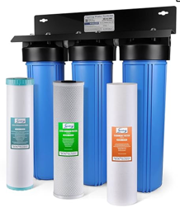
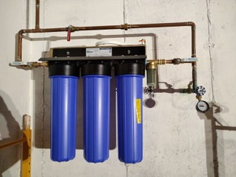
Iron & Manganese Removal
Our house uses 40,000 gallons of water per year. We currently have old Aqua-Pure APIF series residential iron and manganese reduction system Model APIF100DM. It was installed in 2014. The model was discontinued in 2016. It is a big tank filled with media that can last for 2-3 years before service appointments.
We can substitute it with a smaller wall-mounted system that uses replaceable cartridges. This change would offer several advantages: Space-saving, Easy DIY maintenance, cost effective (overall).
Example: multi-stage filtration system like the iSpring WGB32BM
- https://www.youtube.com/watch?v=MSv1jDHGU_c – video description
- https://www.youtube.com/watch?v=svoIxJYPTXo - recent description (does not remove arsenic)
- https://www.amazon.com/dp/B0776ZLQ1V - replacement filters ($106)
- It has 3 stages of filtration, including specialized iron and manganese removal stage 1st stage is a 5 micron sediment filter, 2nd stage – carbon filter, 3rd stage – specialized filter (Fe, Mg)
- Can handle up to 100,000 gallons before replacement
- Is wall-mounted and easy to install
- supports water flow up to 15 gallons per minute
| Feature | Aqua-Pure APIF100DM[1][3] | iSpring WGB32BM[4][6] |
|------------------------|------------------------------------------|----------------------------------------|
| Iron Reduction | Handles high iron concentrations | Reduces from 3.0 ppm → 0.01 ppm |
| Manganese Reduction | Effective for manganese removal | Reduces from 1.0 ppm → 0.01 ppm |
| Process | Air-induced oxidation with MC-10MP media | Catalytic filtration (FM25B cartridge) |
| Max Contaminant Levels | Not explicitly stated | Iron ≤3 ppm, Manganese ≤1 ppm |
| pH Adjustment | Built-in capability | Requires pre-adjusted pH water |
| Flow Capacity | 6 GPM | 15 GPM |
| Maintenance | every 2-3 years | every 6-12 months |
| Installation | Large floor-standing tank | Compact wall-mounted system |
| Ph level | adjusts automatically | |
| High Contaminant Levels| may be better ? | |
Note:
Manganese (Mn): Atomic # 25, transition metal
Magnesium (Mg): Atomic # 12, alkaline earth metal
Iron (Fe): Atomic # 26

Slide 6
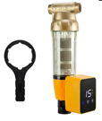
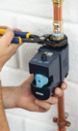

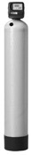
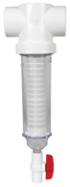
Iron & Manganese whole-house Removal
Moen 900-001 Flo Monitor/Shutoff - https://www.amazon.com/dp/B00C03D01Q
iSpring WSP50ARB - 50 micron, Auto Flushing Module - https://www.amazon.com/dp/B07XLP2T2Y
Rusco 2" 100 Mesh Spin Down Sediment https://www.amazon.com/dp/B005FYN8GE
iSpring WGB32BM 3-stage filtration - https://www.amazon.com/dp/B01FI3BLYM
iSpring WGB12B 1-stage post-filter - https://www.amazon.com/dp/B0785FZYM3 (or 2nd 3-stage filter)
iSpring WCFM400K Iron and Manganese Water Filtration with regeneration https://www.amazon.com/dp/B09L9HBWRX
Auto-Flushing Sediment Filter
or
Rusco Spin Down Filter 2- inch
sed25, sed5, carbon
Aqua-Pure Fe/Mg
Reduction System
Model APIF100DM
or
iSpring WCFM400K Whole House Central Iron and Manganese Water Filter Filtration System
https://www.amazon.com/dp/B09L9HBWRX
Fe/Mg, Fe/Mg, carbon
Flo Monitor/Shutoff

Slide 7
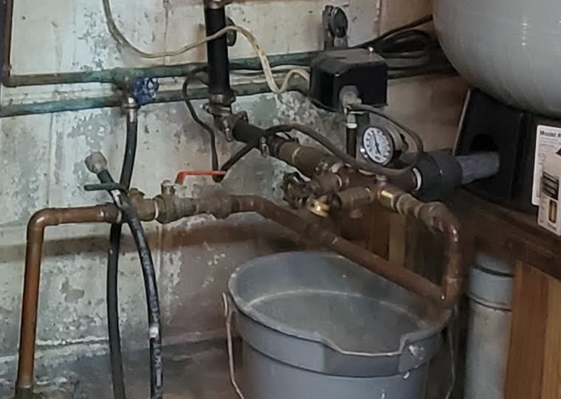
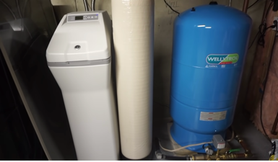
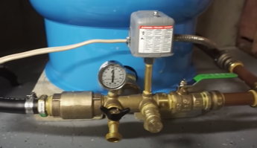
Good overview of how well and tanks work together: .. https://www.youtube.com/watch?v=X4TZoFIsE2w
Check valve (passes water only in one direction)
"Well-T" or "Well Manifold" The gaige shows pressure as it goes up/down Pressure switch turns pump on/off Safety switch (safety valve) to release pressure above ... (75 psi ?)
https://www.amazon.com/Harvard-Boshart-installation-Pressure-pressure/dp/B078WCYK88
$115

Slide 8
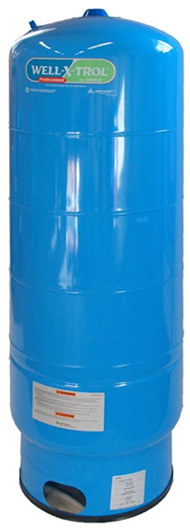
The recommended pressure is 40-60 psi.
If tank and pressure switch are in the basement,
and the water sink is upstairs 5 meters up,
we will lose 5 m * 1.421 psi = 7.1 psi
Pressure decrease due to elevation:
0.433 psi per foot of elevation
1.421 psi per meter of elevation
So, we need at least 50 psi downstairs
to ensure at least 40 psi upstairs.
Why WellXTrol is the BEST Water Well Pressure Tank.
(150 PSI)
.. https://www.youtube.com/watch?v=MmHRJSzZltI
How WellXTroll tanks are made
.. https://www.youtube.com/watch?v=IhBifh7nCtg
Shop Amtrol Well-X-Trol tanks ($700-$1,000):
.. https://www.rcworst.com/Amtrol/Well-X-Trol-c225.html
Standard garden hose in the US has a female connector designed to screw onto the male 3 / 4 inch spigot (tap) with NHT (National Hose Thread).

Slide 9
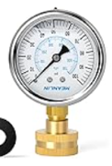
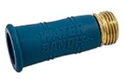
Problem: opening water in the bathtub results in a weak water stream in the sink
Possible reason: water pressure or the plumbing system design (narrow and bent tubes).
Water Pressure: should be around 40-60 psi (pounds per square inch).
You can measure the water pressure using a pressure gauge attached to a spigot outside the house.
Solutions:
- Changing pipes (larger is better)
- Installing a Water Pressure Booster System can help.
- Bigger Water Tank might help if water supply is running low quickly
- Checking for Leaks or Blockages that could reduce the pressure.
Camco Water Bandit
Flexible Silicone-Polymer Sleeve & ABS Male Water Hose Connection
Pressure Gauge 100 Psi
3/4" Female connector

Slide 10
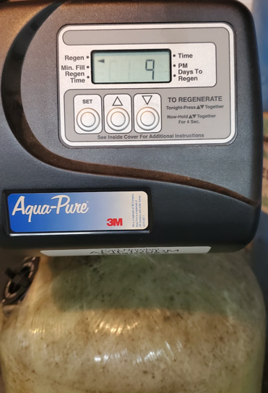
Looks like it needs "regeneration"
(press buttons as instructed for few seconds)
Aqua-Pure
Iron and Manganese Reduction System
Model APIF100DM
SN 613114A519
Serviced 10/2018, 8/2020

Slide 11
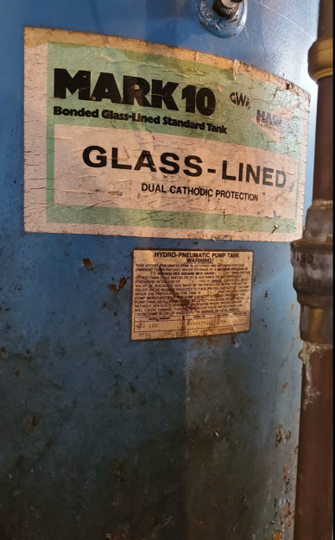
The big blue tank in the middle
Previous owners used it many years ago to clorinate the water. Then they stopped doing this.
But didn't remove the tank.
HARVARD
The American Granby Company, Liverpool, NY
7652 Morgan Rd, Liverpool, NY 13090
https://www.americangranby.com/
MARK 10
Bonded Glass-Lined Standard tank
Glass-Lined
Dual Cathodic Protection
Hydro-Pneumatic Pump Tank

Slide 12
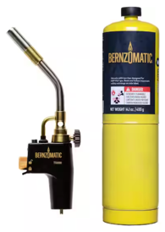

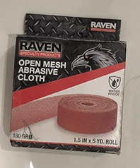
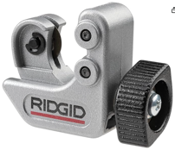
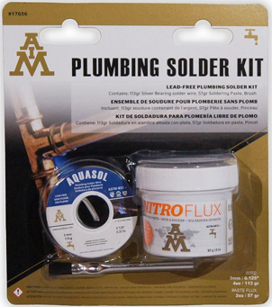
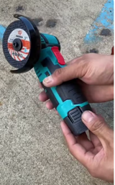
Plumbing
Copper tubing nominal size is internal size:
1 / 2 inch internal = 5 / 8 external
3 / 4 inch internal = 7 / 8 external
===================
torch for soldering using MAPP gas (MAP-Pro) (propane is not hot enough)
- Bernzomatic Trigger Start Torch ( TS8000 ),
- Rothenberger 35645M Quick fire torch ===================
clean outside - mesh sand cloth - https://www.amazon.com/dp/B081BMNG6B clean inside ("fitting" brush) - https://www.amazon.com/dp/B08YS56F4Z/
plumbing flux + brush + solder - https://www.amazon.com/dp/B0BSYD1J7J/
tube cutter - https://www.amazon.com/dp/B001P307PO
copper pipe electric grinder cutter - ...
do not try to re-solder the bad connection – cut it off
buy set of copper tubes and couplings 1/2 and 3/4 inch (straight, angled, converters)
cut tube with special cutter or electric grinder, clean with a file, then with mesh/brush, cover with flux, and immediately do the soldering. Overlap approx one diameter. Heat from outside
Work in thick gloves (to remove extra solder)
Stores:
PlumbersStock
PipingNow
SupplyHouse
Home Depot
Lowe's

Slide 13
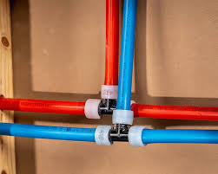
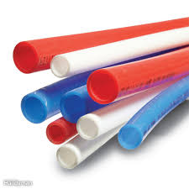
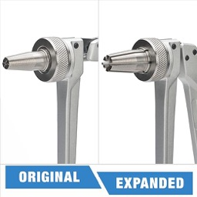
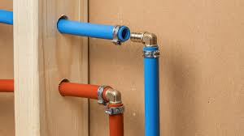
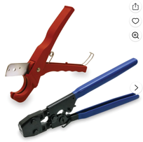
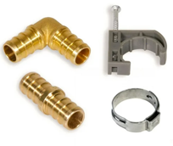
Pex Plumbing
https://www.youtube.com/watch?v=CWgaP90CGmo
PEX plumbing systems are widely used due to their durability, cost-effectiveness, and ease of installation. There are two types: PEX-A and PEX-B
PEX-A – made using the Engel (peroxide) method, which results in the highest flexibility and elasticity. Allows tight bend radii without additional fittings. It also has "thermal memory," enabling kink repairs with heat
PEX-B - Formed using the silane (moisture cure) method, making it more rigid than PEX-A, cannot repair kinks—damaged sections must be replaced
PEX-A - compatible with expansion fittings that match pipe diameters, ensuring unrestricted flow. It can also use crimp, clamp, push-fit, or compression fittings
PEX-B - Typically uses insert-style fittings secured with crimp tools. These fittings reduce water flow due to smaller diameters at joints
PEX-A - Superior freeze resistance due to its ability to expand under pressure, making it less prone to bursting in cold climates
PEX-A is more expensive per foot and requires specialized tools for installation (e.g., expansion tools. Ideal for tight spaces requiring sharp bends. Suitable for systems exposed to freezing temperatures
PEX-B - common for standard residential plumbing due to affordability, best suited for areas where flexibility is less critical
Pex Expander
Pex Cutter and Crimper

Slide 14
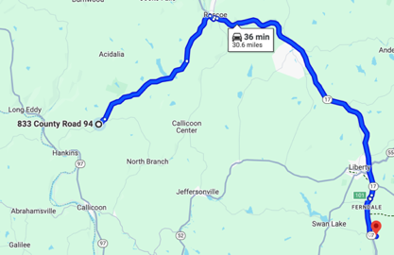
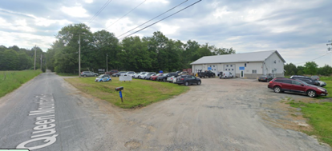
Water Testing
https://www.sullivancountylabs.com/
AG ENVIRONMENTAL RSC LLC ( DBA SULLIVAN COUNTY LABS )
86 Queen Mountain Rd, Ferndale, NY 12734
Open M-F 9-5; tel: (845) 704-8151
7/6/2022 – spoke with Carmen – she mailed testing bottles: tests: 10 metalls ($179) + bacteria + nitrates: $250 total
We can use plastic 750 ml Coca-Cola bottle
Olympian Water Testing
https://olympianwatertesting.com
https://olympianwatertesting.com/drinking/water-testing
461 Columbus Ave, New York, NY 10024
open 9am-9pm every day (including weekends)
tel: 646-328-3931. or 212-461-3879

Slide 15
Aqua-Pure Servicing
Plumber
DJS Plumbing
http://www.djsph.com
Phone number
(845) 887-6309
Recommendations by Cornell Cooperative Extension
http://genesee.cce.cornell.edu/your-home/well-water
==============================
AG Environmental/Sullivan County Labs
.. https://www.sullivancountylabs.com
AG ENVIRONMENTAL RSC LLC
DBA SULLIVAN COUNTY LABS
86 Queen Mountain Rd, Ferndale, NY 12734
(845) 704-8151
==============================
Valley Water Services
https://valley-water.com/contact/
845-887-4770 Kristen
info@valley-water.com
The address in contract:
house: 833 County Road 94, Hankins, NY 12741
barn: 829 County Road 94, Hankins, NY 12741
Former Owners:
Vincent A. Shursky :
Susanne M. Shursky : 845-796-8050

Slide 16
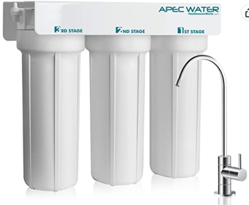
Water Filter under sink
High quality, designed, engineered and assembled in the USA
System built with US MADE super capacity filters (long lasting for tap/well water)
Effectively remove chemicals (i.e. chlorine), taste and odors.
NOT designed for TDS removal (TDS = Total Dissolved Solids, mostly inorganic salts)
Feed Water Pressure 20-85 psi
Installed July 2022
Filters last 1 year
Three filters:
Stage1: 1-SED10 - 5 micron polypropylene filter
Stage2: 23-CAB10 - 10" Extruded Carbon Block Filter
Stage3: 23-CAB10 - 10" Extruded Carbon Block Filter
APEC Water Systems WFS-1000
3 Stage Under-Sink Water Filter System
$140
https://www.amazon.com/gp/product/B00TT9I2PS/

Slide 17
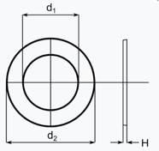
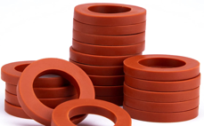
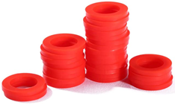
Pipe and washer sizes
Shower: standard 1/2 inch pipe size.
North America (NPT = National Pipe Thread)
British Standard Pipe (BSP) - used throughout Europe, Australia, New Zealand, Asia, South Africa, etc.
Exceptions – some luxury items or very old installations
Standard washer may be made of rubber or silicone.
Standard washer size:
3/4-Inch outer diameter (=6/8 = 12/16)
3/8-Inch inner diameter ( = 6/16)
1/8-inch thickness (3mm)
Alternative I've seen:
11/16-inch outer diameter
9/16-inch inner diameter
Garden Hose: 3/4 inch pipe size.
Buy Heavy Duty Rubber Washer to fit Standard 3/4" Garden Hose Fittings
Typical size:
outer diameter : 1-Inch
inner diameter : 13-18 mm ( 0.51-inch - 5/8-inch)
thickness: 3mm (1/8-inch)

